Slide 1

DEV A Banking Virtual Assistant

Slide 2

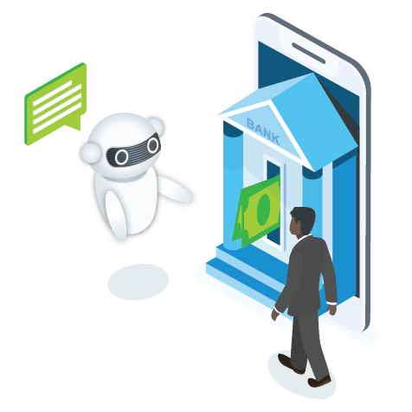
INTRODUCTION
Banking customers often have to go through a lengthy menu of financial products to identify the best suitable option. Besides, they have to put up with a long wait in support calls before their queries, such as account information and balance inquiries, are answered. Virtual banking assists can provide personalized banking assistance to customers round the clock in the banking and financial sector.
Bots have the ability to handle customer requests and queries like an expert and send out alert and notification to ensure stronger engagement.
Processes like new customer acquisition, financial recommendations, customer behavior analysis, fraud detection are better achieved using chatbots and machine learning capabilities. For enhanced decision-making capabilities, bots are imbibed with the best of conversation user experience (CUX) capabilities coupled with data ingestion models.
7
Notes:
Food loss and waste reduction should be seen as a means toward achieving other objectives, including improving food security and nutrition, reducing greenhouse gas emissions, lowering pressure on water and land resources and can increase productivity and economic growth. The formulation of effective policies toward food loss and waste reduction requires comprehensive information as to how much and where – both geographically and along the supply chain – various foods are lost or wasted. FAO’s work on measurement and support to countries to take action to reduce food loss and waste is critical to tracking progress made by countries..

Slide 3
DEV BANKING ASSISTANT
FROM ‘SUFFICIENCY’ TO ‘EFFICIENCY’
The virtual financial assistant Dev is designed to help customers more easily manage their money. Within the interactive interface, Dev converse to answer FAQs, provide reward and account balances, spending summaries, refund confirmations and credit scores. He can also identify duplicate charges and send bill reminders.
Dev will be designed for the customers to :
*More easily manage their money.
*Check on a loan status.
*Facilitating payments with mail alert.
*Getting instant answers to FAQs.
Key Features of the Product :
* Instant Response with automatic time-to-time pop-ups (alerts).
*Proactively reaches out if a bill is higher than normal and send bill reminders.
* Identifies duplicate charges, Suspects fraud and sends mail alert.
*Provides reward and account balances, spending summaries, refund confirmations and credit scores.
--> Chatbots engage the employees over messaging platforms by asking relevant questions to contextualize the responses and automate over 40% of the processes.
7
Notes:
Food loss and waste reduction should be seen as a means toward achieving other objectives, including improving food security and nutrition, reducing greenhouse gas emissions, lowering pressure on water and land resources and can increase productivity and economic growth. The formulation of effective policies toward food loss and waste reduction requires comprehensive information as to how much and where – both geographically and along the supply chain – various foods are lost or wasted. FAO’s work on measurement and support to countries to take action to reduce food loss and waste is critical to tracking progress made by countries..

Slide 4
The State of Food Security and Nutrition in the World, 2020 report
India is home to the largest undernourished population in the world
189.2 million people i.e. 14% of our population is undernourished
20% of children under 5 are underweight
34.7% of children under 5 years of age are stunted
51.4% women in the reproductive age (15-49 years) are anaemic
The Global Hunger Index 2020 ranks India at 101 out of 116 countries
68%
68% of consumers like chatbots because they provide quick answers
80%
Chatbots are projected to handle 75-90% of banking queries by 2022 (CNBC)

Slide 5
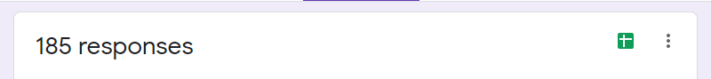
OUR STATs
60% of the customers love to use more interactive way like chatbots.
27% via mobile applications etc.
11% want to go to offline banks.
2% want calls.
AGE – 18 to 30
60%
want to use chatbot

Slide 6

Log In
Log off
DAILY ACTIVITY
Initialize the chat
Rewards
Authenticate
FAQ’S
Loan Status
Transaction History
JUST BY DESCRIBING

Slide 7
DEV – Banking Bot
Dev will be available on all customer touchpoints
Customers visit different digital channels, during banking journey, they require help to fulfill the process requirement, many times customers do not complete the process / transaction as they do not have full information. Virtual Assistant Dev helps to increase the adoption of digital channels and reduce the cost of operation using Proacative Messaging.
Optimal customer experience across Digital, Voice engagements and messaging channels
Dev will be available on all customer touchpoints - web, online banking, app, and interactive voice response.
Using LUIS ML Model Dev will identify the true intent of the conversation and the customer requests
Notes:
*In Big events like Weddings in India, people are tend to prepare extra food for guests
*It's not just limited to events; nowadays, people order food online, and if there's a packaging flaw or a few extra spices, the food is rejected by the customer who paid for it, and it's useless for the restaurant owner as well; he can't deceive his customers by reselling the same item, so the food ends up in the trash.
*Many times we have extra servings of food left with us, we can donate it

Slide 8


OUR VISION
From ‘sufficiency’ to ‘efficiency’
We’ll connect humans to bank.
Dev will be available for the customers to interact 24*7

Slide 9
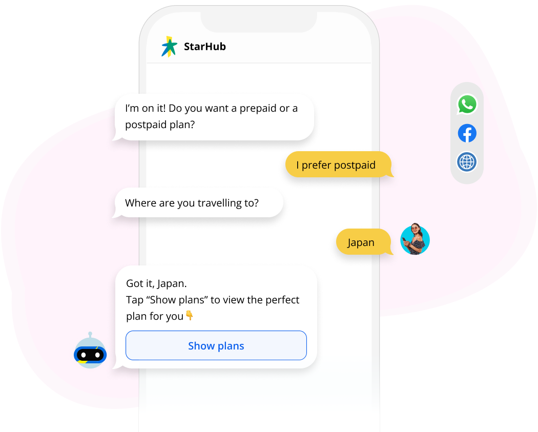
Conversation with DEV
Turn transactions into relationships
DEV
Virtual assistants with voice recognition and personalized insights—not just simple typing and responses to basic inquiries—are the next evolution of AI-powered technology for digital banking and customer service.
I am on it! Do you want to know this months bills?
Yes! pending ones
Mobile Plan is about to expire in a week. Do you want me to show plans
Automate FAQs
Yes!
Help customers check bank balances, find ATMs, check interest rates, and much more. Answer questions about credit or loan applications and get customers the information they need, exactly when they need it.
Got it!
Tap “Show plans” to view the perfect plan for you
Send reminders and notifications
Gives customer peace of mind with reminders about payment deadlines and financial processes. Notify customers about changes in credit scores or relevant news.
Solve urgent issues fast
Offer immediate help when it matters most. Send notifications about suspicious charges and help customers take immediate action.

Slide 10
Step 1
Chat with Dev sharing the details of your Banking Query
Step 3
Incase of a transaction related query, Dev shows the best matched transactions + The alert is sent to users registered mail using Microsoft Power Automate
Step 2
Automated bot Dev will understand your intent using LUIS + Trigger the request with Language Studio QnA Maker to get a response of FAQ.
Step 4
Dev responds with the user understandable language giving a humanly feel

Slide 11
LUIS will be used for intent recognition
Power Automate
Speech to text
(vice versa)
MS Speech Resource
OTP Sent + Verified
FAQs
MS Language Studio QnA
Initialize
Main Features
Automatically get’s updated to COSMO DB
Transaction
History
No
MS Cosmo DB (NoSQL)
Bill Reminders
MS Power Automate
Yes
Log Off

Slide 12





Microsoft
1.
Techstack Used?
Dev will be built over Microsoft Bot Builder Framework using C# language.
IDE – Visual Studio 2022 (Community Version)
Microsoft Language Studio *LUIS
*Speech Resource
*QnA to answer FAQ’s
Hosting platform Azure, i.e. is the second-largest cloud computing platform serving millions of applications, integrations, and customers.

Slide 13
YOU HELD THROUGH !
Thank you!
Prepared by:
Mayank Gupta

